Slide 1

Socket Programming
Mehran rafiee

Slide 2
Contact me
Mail : mehranrafiee5@gmail.com
Social media
  Github: mehran75.github.io
  LinkedIn: mehranrafiee97
  Twitter: mehran97_r

Slide 3
Table of content
Introduction of client / server architecture
Protocols
  Naming some common protocols
  TCP
  UDP
Socket programming
  How it works?
  Practical example
  Assignment

Slide 4
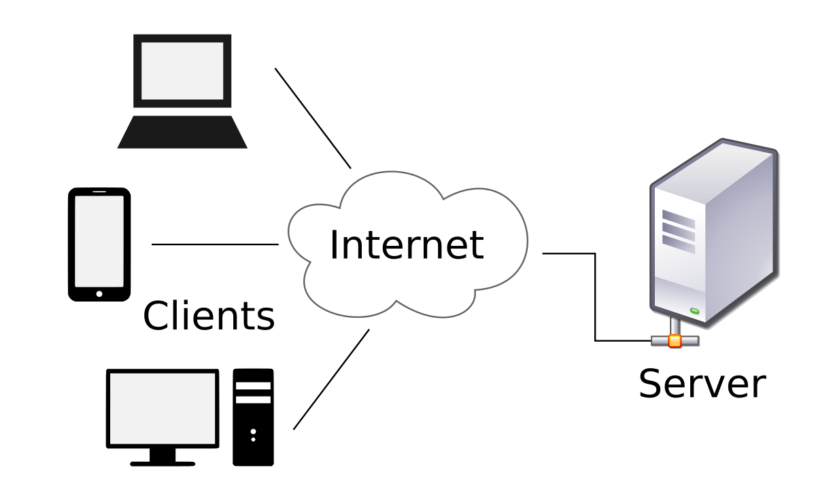
Client / Server architecture

Slide 5
Connection protocols
TCP : Transmission Control Protocol
UDP : User Datagram Protocol
HTTP: Hyper Text Transfer Protocol
SMTP: Simple Mail Transfer Protocol
FTP: File Transfer Protocol

Slide 6
TCP: Transmission Control Protocol
It is the most commonly used protocol on the Internet.
Connection-oriented
  Advantages:
    Declare connection path* once
    Server / client only communicates through declared path
    guarantees the client will receive the packets in order by numbering them
    Client needs to confirm packet received AKA acknowledge packet
    Packets get checked for errors in client
  Disadvantages:
    Lower speed compared to UDP
    A path needed to completely occupied between server and client
    Delay on packet sending
* Path : I mean a physical path between routers from server to client

Slide 7
UDP: User Datagram Protocol
one of the core members of the Internet protocol suite
Connection-less
Advantages:
  No physical path reservation need
  Data packets flows faster compared to TCP
  Less packet overhead compared to TCP
  Small packet size (because of header size – 8 bytes)
Disadvantages:
  No error correction
  Acknowledge packets not needed
  Packet order doesn’t matter
  no guarantee for client getting all the packets
  Client can’t request for getting a packet twice
  No congestion control

Slide 8
TCP and UDP
Both TCP and UDP are protocols used for sending bits of data-AKA packets-over the Internet
UDP is not reliable
TCP needs to create a connection first (hand shake)
TCP has congestion control so data not always sent immediately
UDP has smaller header size (8 bytes for UDP and 20 bytes for TCP)
TCP has a lot more overhead
UDP is message-oriented but TCP is stream-oriented

Slide 9
There is no better
We often use TCP if
  All data should be completely transfer
  Overhead doesn’t heard performance
  Our firewall is not ok with UDP packets
We often use UDP if
  Speed is more important
  Delay is not acceptable
  Data loss can be masked

Slide 10
Socket programming

Slide 11
Socket programming
Bind
Wait for client
Receive message
Generate respond
Send message to client
Server

Slide 12
Socket programming
Connect to server
Send request
Manage respond
Close connection
Client

Slide 13
Implementation
Open files below:
  session_1_socket_server.ipynb
  session_1_socket_client.ipynb
Link on github: session_1
Socket documentation: https://docs.python.org/2/howto/sockets.html

Slide 14
Thank you

